Slide 1

NeuroDOT 2.2.0 Base
Appendix - Atlases

Slide 2
Introduction
This appendix is intended to educate new users about anatomical atlases and how they fit into NeuroDOT 2.

Slide 3
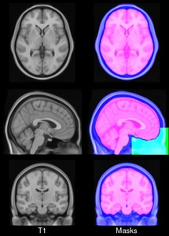
What Is An Atlas?
An atlas is an idealized model created from a pool of subjects.
We use atlases in neuroscience to standardize data from multiple acquisitions and/or subjects into a uniform space.
We do this because we want to know that when we're pointing at a specific region of the brain, we're getting the same region from all of our patients, even though the individual brains come in all different shapes and sizes.
Image:
http://nist.mni.mcgill.ca/?p=858
MNI ICBM152 non-linear

Slide 4




A Plane Example
In the last 100 years of aviation, hundreds of commercial airliners have been designed and manufactured.
Let's say we wanted to create an atlas of control systems (an analogous structure to the brain) for commercial 2-engine airliners. We might do this by averaging together the surface maps of a handful of 2-engine airliners.
Wikipedia: Boeing 717, 727, 757, 767

Slide 5


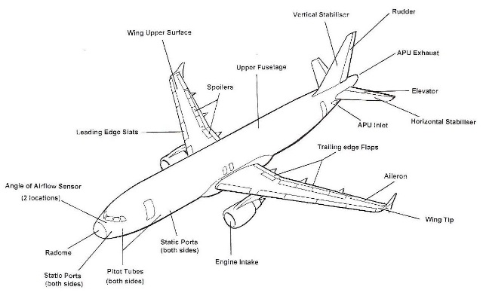


A Plane Example
From the 2-engine airliner atlas, we would then be able to create a spatial transform between each individual airliner's model and this atlas.
With these transforms, we would then have a way to compare the control systems of all planes against each other.
Left Image:
https://commons.wikimedia.org/wiki/File:Aircraft_Parts_eng.jpg

Slide 6
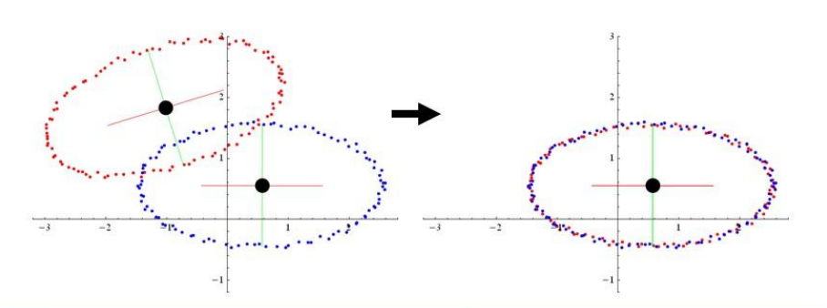
What Is Registration?
Registration is the process of standardizing data from multiple acquisitions and/or subjects into a uniform space, such as an atlas.
In medical imaging, an image or volume is said to be "registered to" or "co-registered with" another if it has been spatially transformed such that their anatomies align.
Source: Tao Ju, Washington University in St. Louis, CSE 554A, Lecture 8: Rigid Alignment

Slide 7
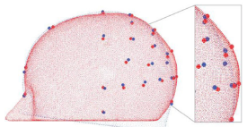
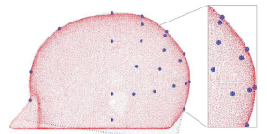
Rigid vs. Nonrigid Registration
Registration can be rigid or nonrigid (alternatively, linear or non-linear, respectively)
Rigid registration does not deform parallel lines in a space.
Nonrigid registration does deform parallel lines in a space.
Both types can be useful for creating atlases, or aligning data from patients with different sized and shaped heads to an atlas to make direct functional comparisons.
Top: Rigid
Bottom: Non-rigid
Source: Ferradal, Neuroimage 2014, "Atlas-based head modeling and spatial normalization for high-density diffuse optical tomography: In vivo validation against fMRI".

Slide 8
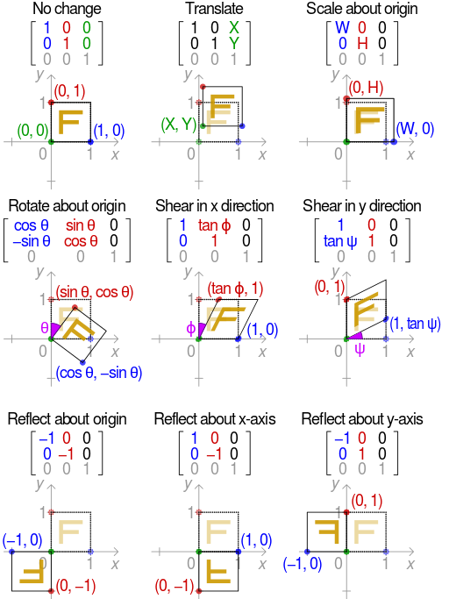

Affine Transforms
$$\left[\begin{matrix}\begin{matrix}a & b \\ e & f\end{matrix} & \begin{matrix}c & d \\ g & h\end{matrix} \\ \begin{matrix}i & j \\ 0 & 0\end{matrix} & \begin{matrix}k & l \\ 0 & 1\end{matrix}\end{matrix}\right]$$
Right: A 3D affine matrix
One common method of rigid registration is to use affine transforms.
3D affine transforms can be represented with a 4x4 matrix.
An affine transform can perform several spatial transformations at once: translation, reflection, scaling, rotation, and shearing.
Left: Several 2D affine transform examples.
Source: https://en.wikipedia.org/wiki/Affine_transformation#/media/File:2D_affine_transformation_matrix.svg

Slide 9
The MNI 152 Atlas
The Montreal Neurological Institute (MNI) has produced a number of atlases for neuroimaging, among which is the base atlas used in NeuroDOT 2, the MNI 152.
This atlas was created by registering and averaging 152 MRI scans of normal patients together, using linear and non-linear methods.
The methodology emphasized aligning brain structures over all others, so surrounding tissues like the bone can look blurry compared to a relatively-well defined brain.

Slide 10
The MNI 152 Atlas (non-linear)
Source: http://nist.mni.mcgill.ca/?p=858

Slide 11
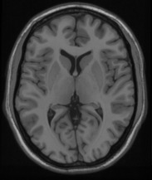
Fuzziness
MNI 152 Non Linear
Colin 27 Average Brain 1998
We see that the MNI 152 atlas's skull (left) is much fuzzier than the single-subject Colin 27 atlas (right), where we can make out different tissues and more individual variation.
Source: http://nist.mni.mcgill.ca/?p=858

Slide 12
Atlas Segmentations
A segmentation divides an image or volume into regions of interest, labeling tissues differently based on certain criteria.
Segmentations are commonly computed for atlases. In the right-most column of images, we can see the segmentation for the MNI 152 atlas, which divides the volume into brain, head, and eye masks.
Other segmentations might differentiate bone, meninges, and grey & white matter.
Source: http://nist.mni.mcgill.ca/?p=858

Slide 13
Canonical Spaces
For any given atlas, such as the MNI 152, there can be a number of sub-varieties which exist in different spaces.
Canonical spaces are a popular handful of such spaces chosen for qualities such as universality or correspondence to a specific modality's point spread function (resolution).
In NeuroDOT 2, we describe these spaces mathematically with several vectors and scalar values.

Slide 14
Canonical Spaces: mmx, mmy, mmz
The quantities mmx, mmy, and mmz give the voxels' dimensions in millimeters for each axis.
z
mmy = 1mm
mmz = 1mm
y
mmx = 1mm
x

Slide 15
Canonical Spaces: nVx, nVy, nVz
nVx, nVy, and nVz give us the number of voxels in each dimension.
nVy = 10
y
z
10
9
8
7
nVz = 10
6
5
4
3
2
1
2
3
4
5
6
7
8
9
10
x
nVx = 10

Slide 16

Canonical Spaces: center
The center of the canonical space is defined as a vector projecting from the center of voxel (0, 0, 0) to the center of the space.
z
voxel space
$$center=(a,b,c)$$
y
voxel (0,0,0)
x

Slide 17
Non-Isotropic Spaces
Non-isotropic spaces have different mmx, mmy, and mmz values.
nVy = 2
mmy = 5mm
y
z
1
2
5
nVz = 5
mmz = 2mm
4
3
2
1
2
3
4
5
6
7
8
9
10
x
nVx = 10
mmx = 1mm

Slide 18
Canonical Spaces for MNI 152
Here are a few of the MNI 152 atlas's canonical spaces that NeuroDOT 2 uses:
"T1_on_333" - A 3 x 3 x 3 mm voxel size. The low resolution allows for faster imaging and processing.
"T1_on_111" - A 1 x 1 x 1 mm voxel size. The higher resolution allows for greater detail in analysis.
The "T1" reflects that the original MRI images are T1-weighted. This provides better fat sensitivity.

Slide 19
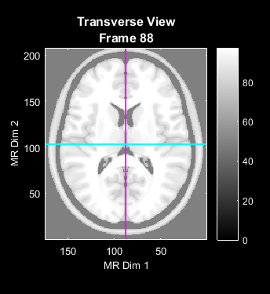
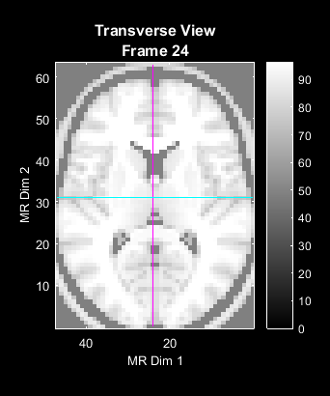
The 111 and 333 Spaces
To the right are two examples of the 111 and 333 spaces for the MNI 152 atlas.
We see quite clearly that the voxel size is related to the image resolution.
Since the # of voxels increases cubically with decreasing voxel size, varying that size allows a trade-off between detail and processing speed.
T1_on_111
T1_on_333

Slide 20
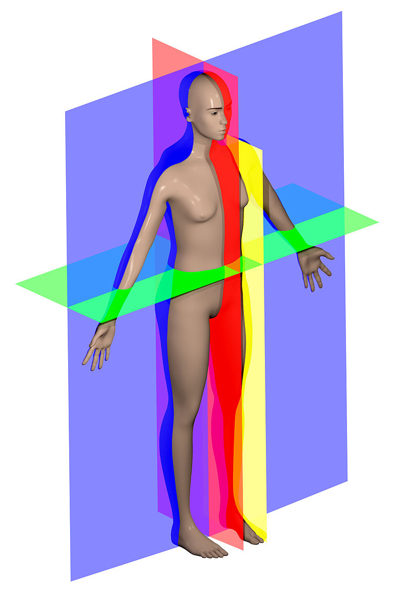
Anatomical Axes
There are three anatomical axes in medical imaging:
Transverse (green in image)
Sagittal (red in image)
Coronal (blue in image)
These correspond to the 6 cardinal directions in medicine:
Transverse = Dorsal-Ventral (up/down)
Sagittal = Left-Right
Coronal = Anterior-Posterior (front/back)
Image: Richfield, David (2014). "Medical gallery of David Richfield". WikiJournal of Medicine 1 (2). DOI:10.15347/wjm/2014.009. ISSN 2002-4436. - Own work

Slide 21
Orientation
Typically, we store an image volume as a 3D array. Each dimension of the array corresponds to one of the anatomical axes.
In order to properly display an image volume, we need to know which dimension corresponds to which axis, and in which direction (as in, L->R, or R->L?).
This correspondence is called an orientation. There are two standard orientations that ND2 uses: "transverse", and "sagittal".

Slide 22
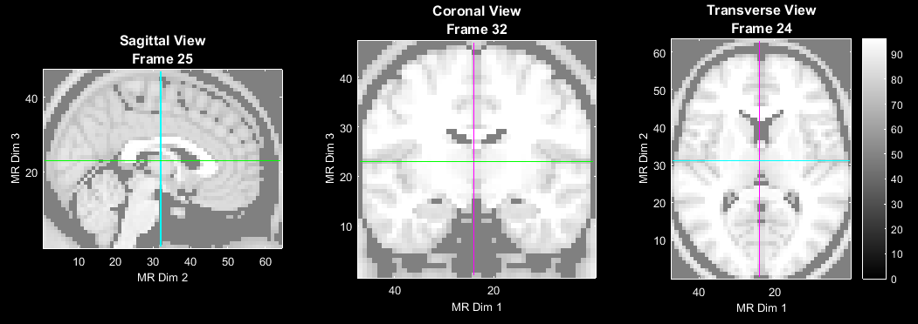
Transverse Orientation
In the transverse orientation, array dimensions 1-2-3 correspond to Sagittal-Coronal-Transverse.
Values increase from R to L in the Sagittal axis, posterior to anterior in the Coronal axis, and ventral to dorsal in the Transverse axis.

Slide 23
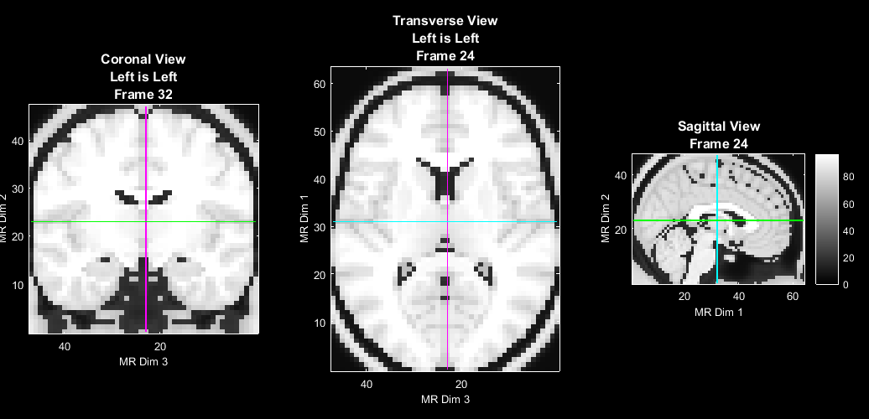
Sagittal Orientation
In the sagittal orientation, array dimensions 1-2-3 correspond to Coronal-Transverse-Sagittal.
Values increase from posterior to anterior in the Coronal axis, ventral to dorsal in the Transverse axis, and R-L in the Sagittal axis.

Slide 24
That’s It (For Now)
Congratulations! You have finished the NeuroDOT 2 Base Appendix - Atlases.
For further questions or more information, please consult the NeuroDOT 2 Base User Manual and the various Appendices.
NeuroDOT 2 Team:
Adam Eggebrecht (aeggebre@wustl.edu)
David Muccigrosso (muccigrosso.david@wustl.edu)

